Slide 1
Version Control System
(Sub)Version Control (SVN)

Slide 2
SVN Login
Your ID/Password are the same as your accessID(xx1234)
Your ID will show up with every commit you make, so make sure that your program compiles before you submit.
If someone else submits something with your ID, YOU are responsible! So protect your ID from others.

Slide 3

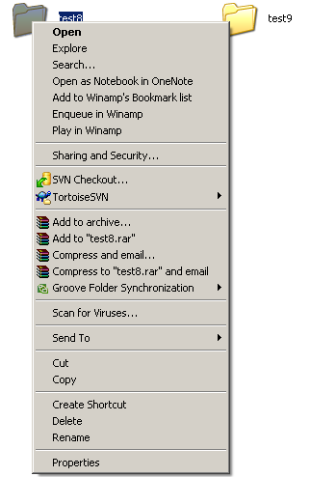
SVN client - TortoiseSVN
Open source application – download it from
  http://tortoisesvn.net/downloads.html
After the installation a new
option appears in the menu when
you right click on a folder
*This is for your home computer,
the lab computers have it already.

Slide 4
How to checkout
Right click in the folder you want to check out into
Select SVN Checkout…

Slide 5
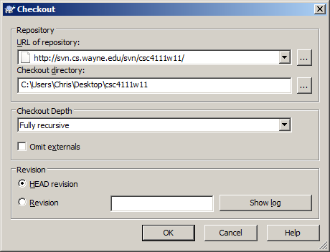
How to checkout
URL of repository:
  You can create your own repository on:
    https://svn.wayne.edu

Slide 6
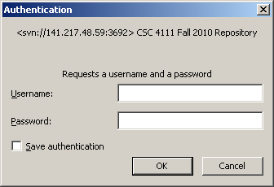
How to checkout
Enter the user name and password:
  Your accessID (xx1234) and the same password you use for Pipeline/Blackboard

Slide 7
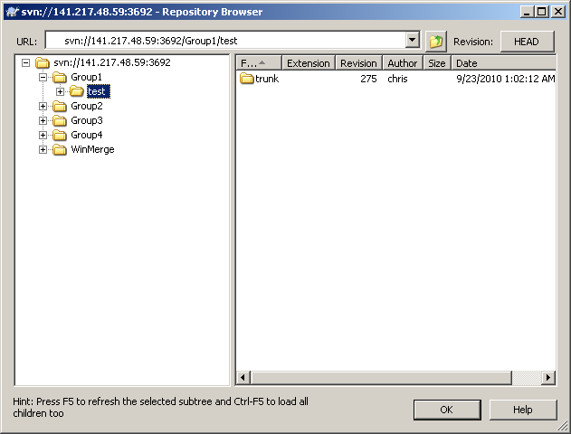
How to checkout
Select the project you want to download:
For this assignment we are using the “test” project.

Slide 8
Update
If you have a set of files checked out and would like to update them to the most recent version of files in the repository, use the update command.
If there are newer files in the repository, they will overwrite any files you have locally, if you haven’t changed them.
TortoiseSVN can merge some files on its own, but may tell you there are conflicts with others.
If a file has a conflict use diff.

Slide 9
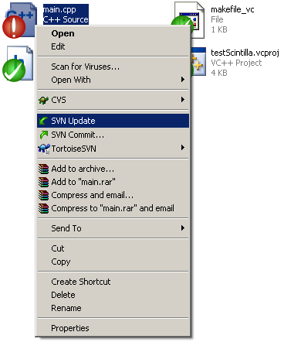
How to update
Right click on the file, folder or project you want to update and choose SVN Update

Slide 10
Commit
Once you have added, deleted, or changed files or directories, you can then commit those changes to the repository.
Before committing you should always update.
The safest way to commit, is to diff your project before you commit.
Always check your project out after a commit and make sure it compiles.

Slide 11
Commit Comments
All commits need to be commented.
If you forget to comment, make a trivial change to a file and commit adding in your comment that it applies to the previous commit.
Include:
  Your Name
  The type of commit (Change, Bug Fix, …)
  What the commit does (Adds ToolTip dialog …)
  Any other important details
Don’t include:
  The names of the files (The log will have them)
  The date or time

Slide 12
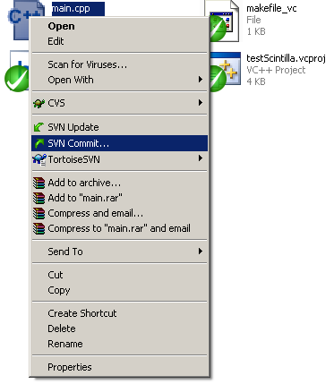
How to commit
Right click on the file, folder or project you want to update and choose SVN Commit…

Slide 13
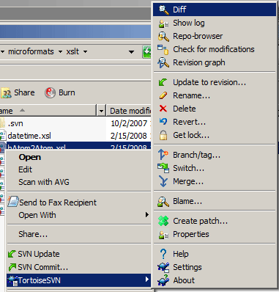
How to Diff
Right click on the file you want to diff.
Select Diff, this will compare your file to the most recent (Head) version on the repository. In a new window

Slide 14
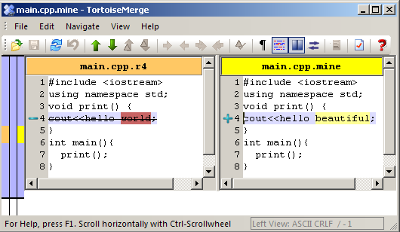
Diff - How to solve conflicts
If just a word changed, it will be in red on one side yellow on the other
You can use the green arrows to navigate through the differences.

Slide 15
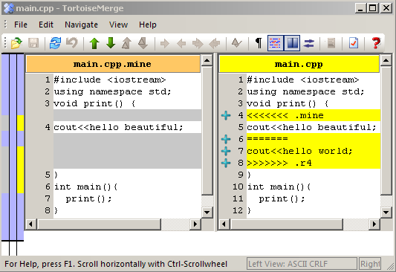
Diff - How to solve conflicts
If lines were added/deleted one side will have gray the other yellow.
The Edit menu has options to help you combine the files.

Slide 16
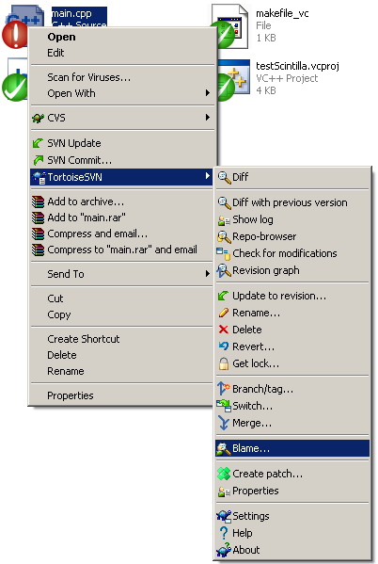
Finding who changed who to blame
This feature isn’t only to “get someone in trouble”. If you have a conflict, this will tell you who changed each line of code in the file. That way you can communicate with them to resolve the conflict.

Slide 17
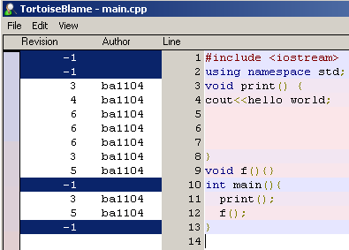
“Blame” feature

Slide 18
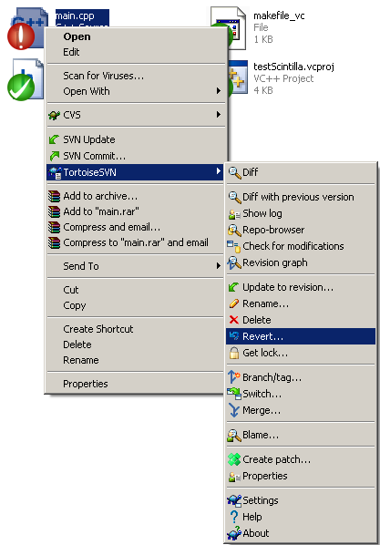
If conflict cannot be solved you can revert your changes
This will only revert the copy of the file on your computer, not in the repository.

Slide 19
To see the log of changes
Use the same steps as Diff, but choose “Show log” instead of “Diff”.
This can be done with a file, folder, project or entire repository.

Slide 20
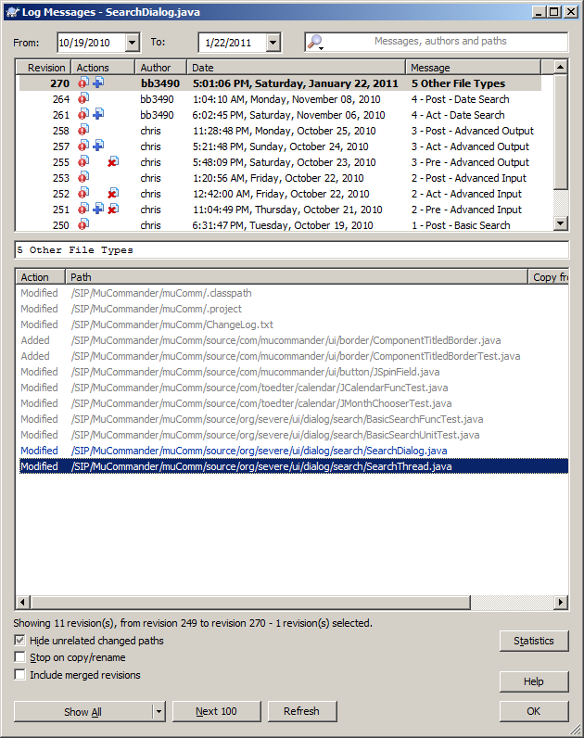
To see the log of changes
The left column is the version number. It can be entered in the Checkout dialog to get that version instead of the “Head” version.
The bottom shows all the files added/modified/deleted in that revision

Slide 21
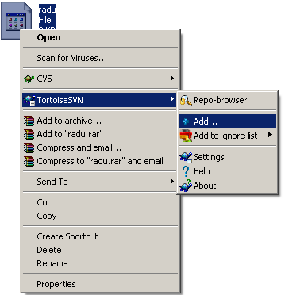
Adding new files
Before you commit make sure you add the file into the repository
After you add - commit

Slide 22
If you make a bad commit
If your commit breaks the baseline.
Update your local copy
Check out the last good version
Commit this version

Slide 23
When to commit
Commit to mark a working state that you might want to return to later.
Commit related files in a single operation. Use a common log message for all the files.
Commit to backup your sources.
Commit from an office desktop to be able to access the files from home much faster than through filesystem sharing.

Slide 24
Rules on using SVN
Carefully test your code before committing
Before committing, perform an update on the whole source code directory, and then retest
Always commit only the individual files you modified, not the entire directory
When adding new files to the existing source code, always perform SVN Add and then SVN Commit
When you have conflicts, contact the teammates which modified that file and try to solve the conflicts together to avoid damages.

Slide 25
Rules on using SVN (contd.)
You will be responsible for any changes submitted using your username and password!
Do not check out other projects than the one assigned to you! It can be easily verified…
You are completely responsible for any faults your changes introduced in the existing software or your colleagues’ changes! Always test, update, resolve conflicts and then retest before committing!!!
Always write comments in the dialog box when committing a file, including your name, student ID, number of change request(1,2 or 3) and the change request itself – do this for each file you modify/add/delete

Slide 26
Rules for the class project
Do not add any file from the build or debug directory, such as and *.exe, *.dll files.
Visual Studio makes files to save your preferences do not commit these. They have names like MergeX64.vcproj.YourComputerName.YourID
In general you should only add:
  Source files *.cpp, *.h
  Solution files *.sln, *.vcproj just not the one above.
  Resource files *.rc
  Image files (for icons) *.bmp, *.ico
Always include a comment when you commit.

Slide 27
Notes on using SVN
Do not share your login and password – you are responsible for all changes made with your ID
Do not check out projects of other groups !!!
If you check in modifications to the project of other group you might be responsible for that
If you do not understand something, please ask GTA before doing that
If you do not like a client that we’re suggesting you to use, you’re free to use any other available SVN client (but please notify me and write a couple of lines explaining why)

